Slide 1
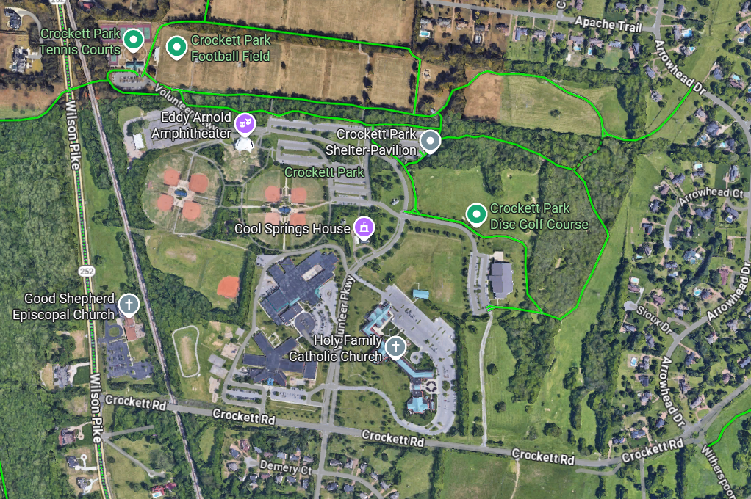
1500 Volunteer Parkway
8
5
PARKING
For 1,2,3,4
3
4
PARKING
For 5,6,7,8
7
6
2
1
WOODLAND
MIDDLE
CROCKETT
ELEMENTARY

Slide 2
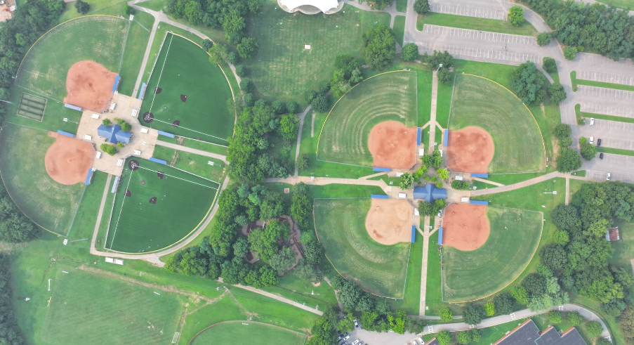
BACK QUAD
FRONT QUAD
Field #8
Concessions
Field #5
Batting Cages
Field #3
Field #4
Bathrooms
Bathrooms
Field #7
Field #6
Field #2
Field #1
As of 09/01/24: The back quad is now all turf.

